Slide 1
CUSTOMER BOOKING PREDICTION

Slide 2
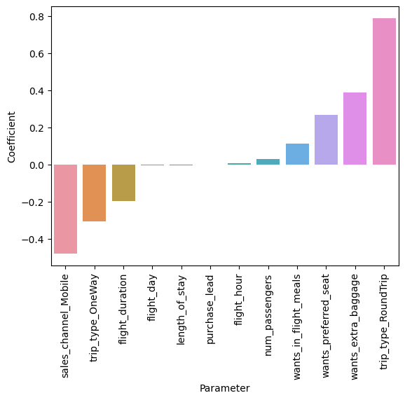
FINDINGS
The Model had an accuracy of 58%, Precision of 20%, and Recall of 63%
Trip type (Round Trip) had the most positive impact of the log loss
Wanting in flight meal, preferred seat and extra baggage also had positive impact on the log loss
Sales Channel (Mobile), trip type (One Way) had negative impact on the log loss

